Slide 1

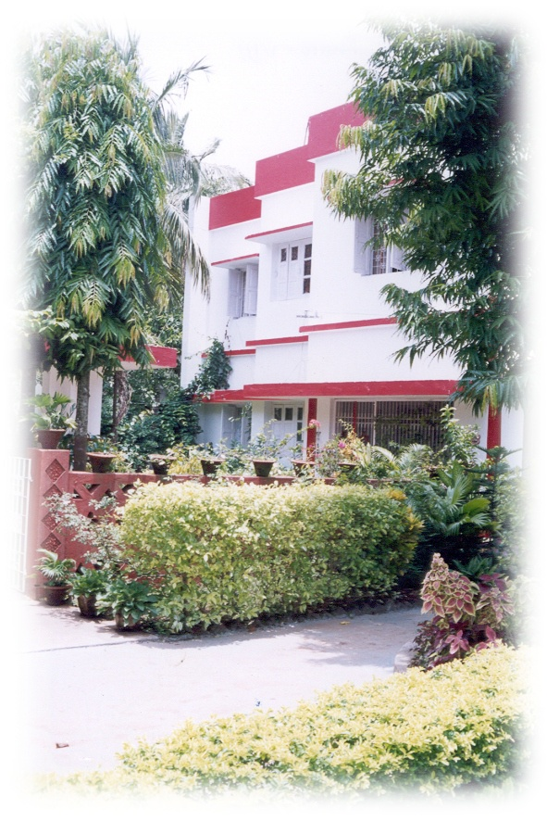
SRI GOURANGA SEVA SADAN
A – 19, SAHEED NAGAR , BHUBANESWAR

Slide 2
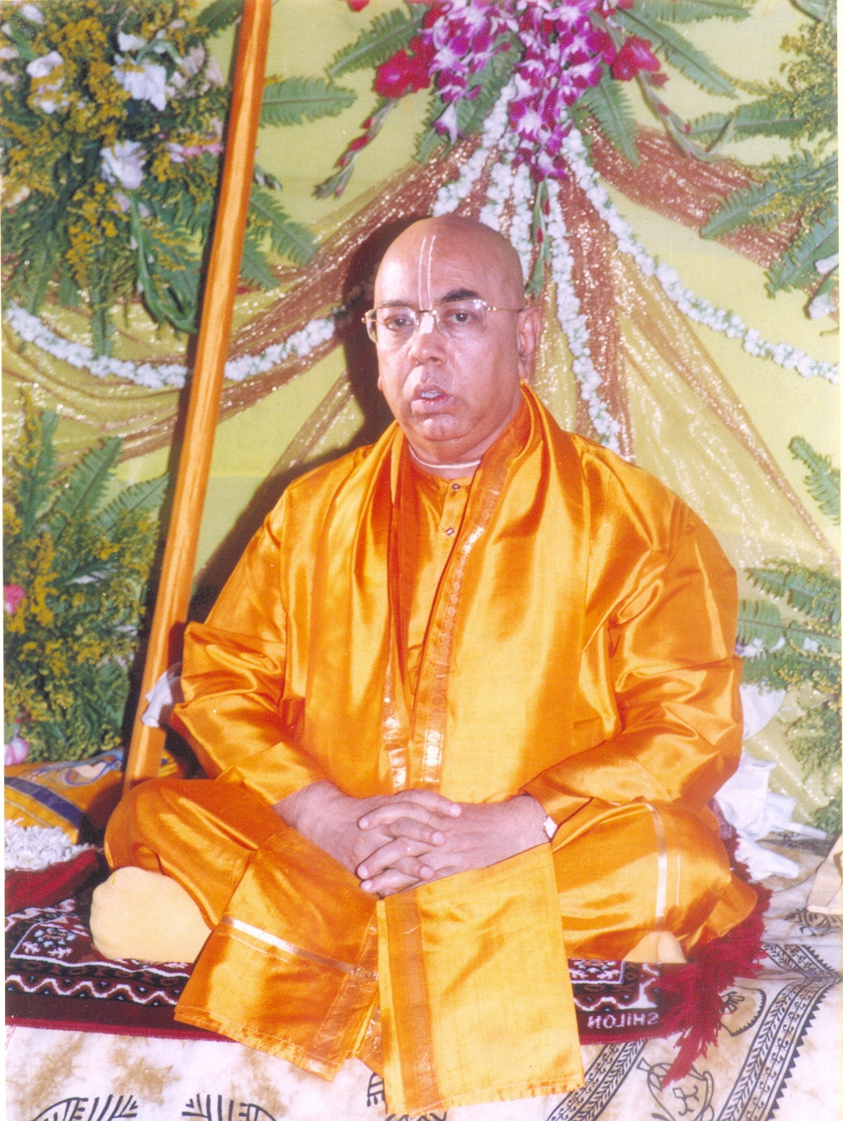
HIS DIVINE GRACE OM VISHNUPAD 108 TRIDANDI SWAMI
SRI SRIMAT BHAKTI SRAVAN TRITHA GOSWAMI MAHARAJ,
FOUNDER ,SRI GOURANGA SEVA SADAN

Slide 3
“ SWASTHA SEVA
PARAM SEVA”

Slide 4
MEDICAL CAMPS
ORGANISED BY
SRI GOURANGA SEVA SADAN
FROM
JANUARY 2011– JUNE 2011

Slide 5
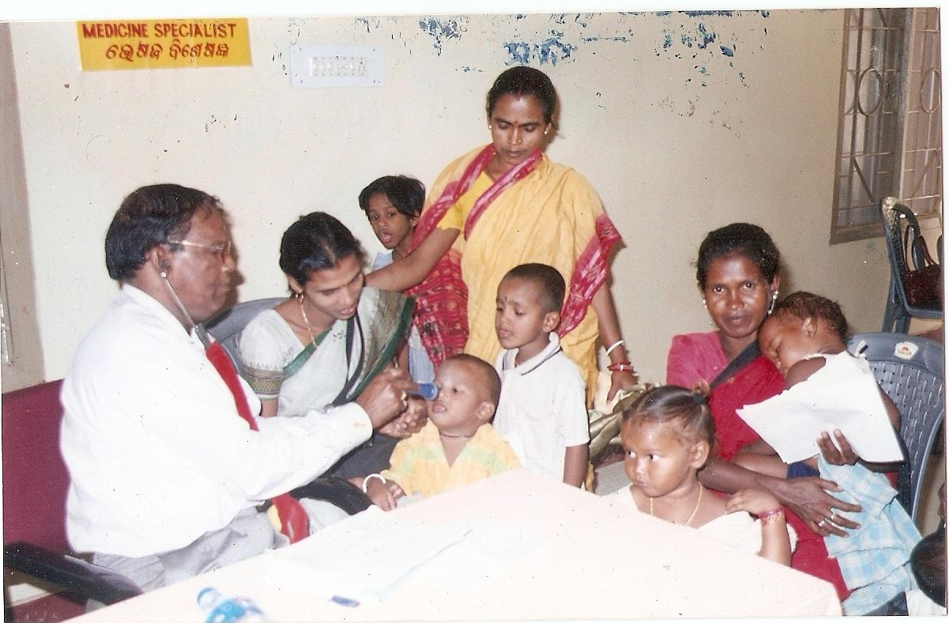
MEDICAL CAMP AT ORPHANAGE AT KHANDAGIRI, BHUBANESWAR
01/O1/2011

Slide 6
MEDICAL CAMP AT ORPHANAGE AT KHANDAGIRI, BHUBANESWAR
01/O1/2011
THE ORPHANAGE AT KHANDIGIRI SUPPORTS 200 CHILDREN PROVIDING THEM WITH SHELTER, CLOTHES AND EDUCATION EVENTUALLY FACILITATING THEIR REHABLITATION. SEVA SADAN HAS BEEN PROVIDING MEDICAL SERVICES SINCE THE PAST 10 YEARS.
NUMBER OF PATIENTS : 250
FREE MEDICAL CHECKUP BY
  MEDICINE SPECIALIST
  SKIN SPECIALIST
  GYNAECHOLOGIST
  PEDEATRICAN
FREE DISTRIBUTION OF MEDICINE
BLOOD GROUPING

Slide 7
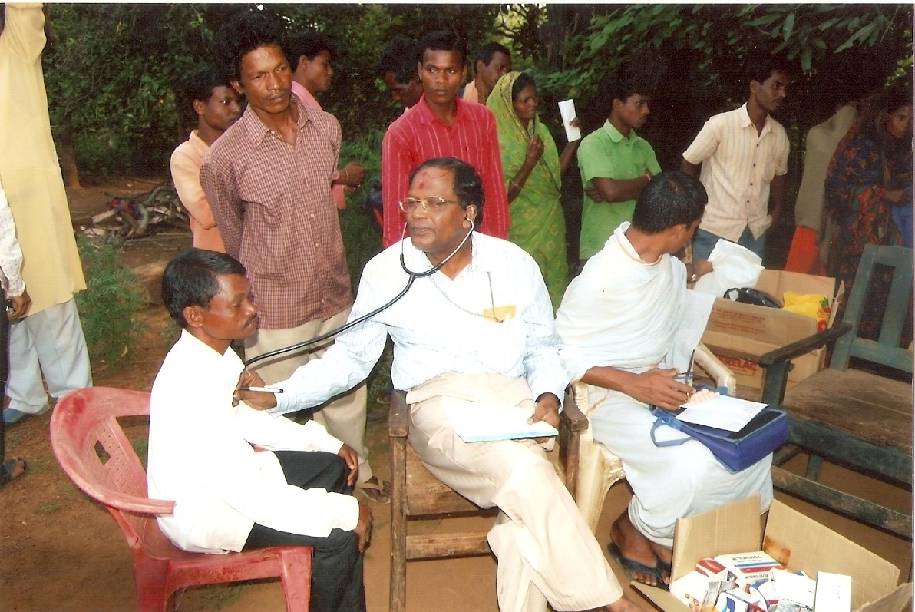
MEDICAL CAMP AT VILLAGE PATRAPADA, KHURDA
26/01/2011

Slide 8
MEDICAL CAMP AT VILLAGE PATRAPADA, KHURDA
26/01/2011
PATRAPADA IS A SMALL VILLAGE 15KMS FROM BHUBANESWAR. THE INHABITANTS ARE MOSTLY DAILY WAGE LABOURERS.
NUMBER OF PATIENTS : 500
MAJOR DISEASES
  SCABIES
  FUNGUL INFECTION
  WORMS INFESTATION
SERVICES PROVIDED
  FREE DISRIBUTION OF MEDICINE
FREE CONSULTANCY BY
  MEDICINE SPECIALISTS
  PEDEATRICIAN
  SKIN SPECIALIST

Slide 9
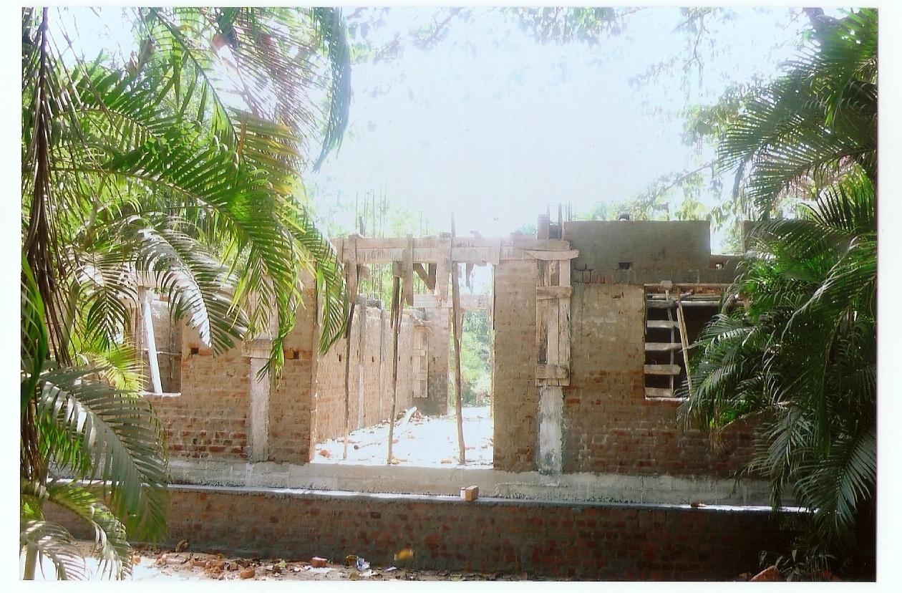
CHARITABLE DISPENSARY UNDER CONSTRUCTION AT BHUBANESWAR
24/02/2011

Slide 10
CHARITABLE DISPENSARY UNDER CONSTRUCTION AT BHUBANESWAR
24/02/2011
THE NEW CHARITABLE DISPENSARY IS BEING CONSTRUCTED IN THE PREMISES OF SRI GOURANGA SEVA SADAN AT BHUBANESWAR. THE CONSTRUCTION WORK STARTED ON 2ND JANUARY 2011.
TARGET GROUP : THE UNDERPRIVILIGED
PRIMARY OBJECTIVE
TO PROVIDE FREE MEDICAL CONSULTANCY BY SUPERSPECAILISTS FROM DIFFERENT DEPATMENTS.
TO PROVIDE FREE TREATMENT BY WAY OF MEDICINE, DRESSING ETC.
PHYSIOTHERAPY .
HOST BLOOD DONATION CAMPS.
HOST AWARENESS CAMPS.

Slide 11
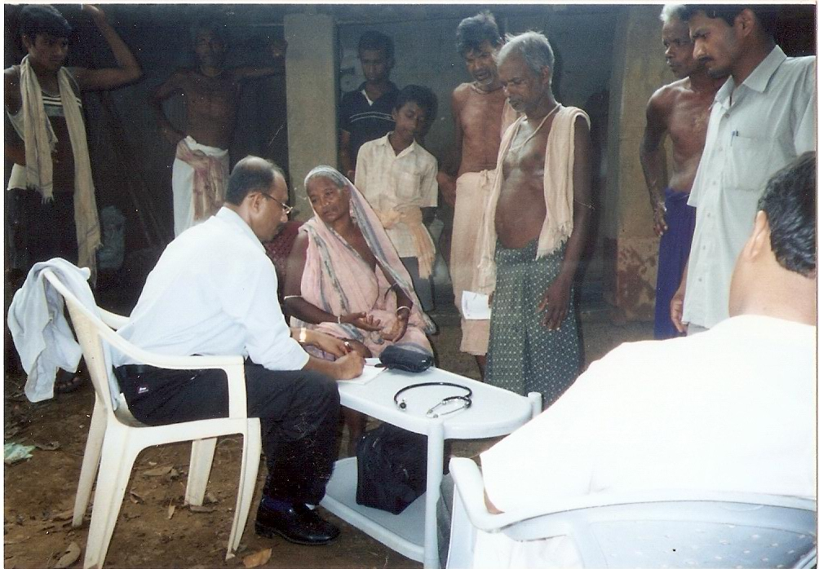
MEDICAL CAMP FOR THE SENIOR CITIZENS IN MENDHASALA BASTI
27/02/2011

Slide 12
MEDICAL CAMP FOR THE SENIOR CITIZENS MENDHASALA BASTI, 27/02/2011
MENDHASALA IS A VILLAGE 20 KMS FROM BHUBANESWAR IN THE DISTRICT OF KHURDA.THE POPULATION MOSTLY COMPRISES OF FARMERS AND DAILY WAGE LABOURERS. A CAMP ESPECIALLY FOR THE OLD WAS ORGANIZED BY THE SEVA SADAN.
NUMBER OF PATIENTS : 200
MAJOR DISEASES
  ANEMIA.
  OSTEOPOROSIS.
  ARTHIRITIS.
  BLOOD PRESSURE AND DIABITIES
  CATARACT.
SERVICES PROVIDED
FREE CONSULTANCY BY.
  MEDICINE SPECIALISTS.
  ORTHOPAEDIC.
  OPTHALMOLOGIST.
FREE DISRIBUTION OF MEDICINE. NUTRITIONAL SUPPLEMENTS. BASIC EXERCISES FOR
ARTHIRITIS.

Slide 13
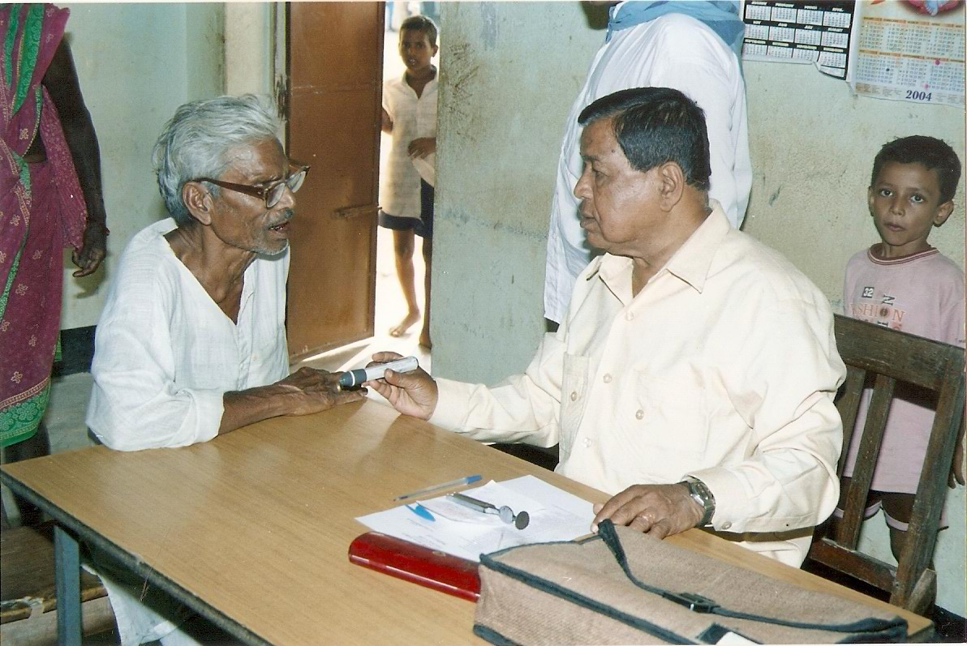
MEDICAL CAMP VILLAGE ANANTAPUR, CUTTACK
02/03/2011

Slide 14
MEDICAL CAMP VILLAGE ANANTAPUR, CUTTACK
02/03/2011
ANANTPUR IS A VILLAGE IN DISTRICT CUTTACK. THE MAJOR OCCUPATION IS AGRICULTURE AND FARMING. A MULTIDISCIPLINARY MEDICAL CAMP WAS CONDUCTED.
NUMBER OF PATIENTS :700
MAJOR DISEASES
  GASTREONTOLOGICAL DISORDERS.
  SCABIES.
  FUNGUL INFECTION.
  WORMS INFESTATION.
SERVICES PROVIDED
FREE CONSULTANCY BY
  MEDICINE SPECIALIST.
  PEDEATRICIAN.
  GASTREONTOLOGIST.
  GYNAECHOLOGIST.
FREE DISRIBUTION OF MEDICINE
AWRAENESS ABOUT IMPORTANCE OF MAINTAINING PROPER HYGIENE AND SANITATION IN PREVENTION OF DISEASES

Slide 15
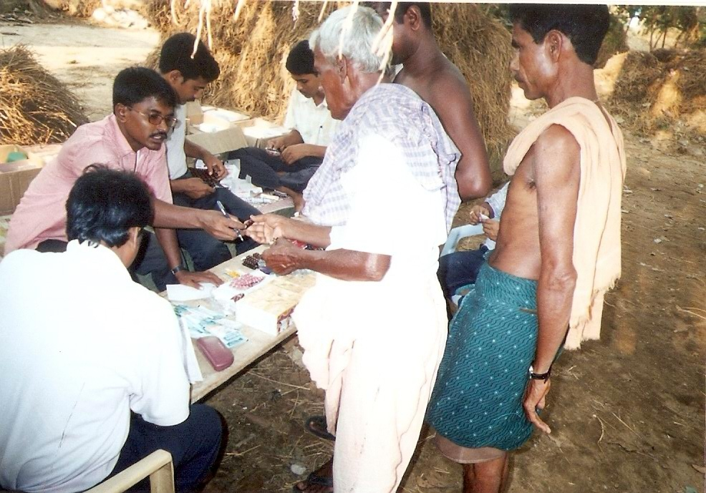
DISTRIBUTION OF MEDICINE AT MEDICAL CAMP KALAYANPUR, NAYAGARH
25/03/2011

Slide 16
DISTRIBUTION OF MEDICINE AT MEDICAL CAMP KALAYANPUR, NAYAGARH
25/03/2011
KALAYANPUR IS A VILLAGE IN THE DISTRICT OF NAYAGARH. THE MAJORITY OF THE POPULATION ARE FARMERS AND ARTISANS.
NUMBER OF PATIENTS 800
MAJOR DISEASES
  AMEBIOSIS
  RESIPRATORY DISORDER/FEVER
  SKIN DISEASE
SERVICES PROVIDED
FREE CONSULTANCY BY
  MEDICINE SPECIALIST.
  CHEST SPECIALISTS.
  GASTREONTOLOGIST.
FREE DISRIBUTION OF MEDICINE.
AWRAENESS ABOUT IMPORTANCE OF MAINTAINING PROPER HYGIENE AND
SANITATION IN PREVENTION OF DISEASES.
DISTRIBUTION OF BLEACHING POWDER AND HALOGEN TABLETS.

Slide 17
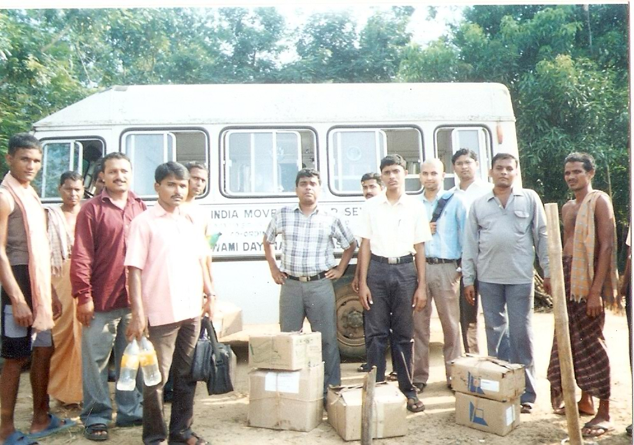

MOBILE VAN WITH VOLUNTEERS AT MEDICAL CAMP AT SHIKHARCHANDI BASTI, BHUBANESWAR
15/04/2011

Slide 18
MOBILE VAN WITH VOLUNTEERS AT MEDICAL CAMP AT SHIKHARCHANDI BASTI, BHUBANESWAR
15/04/2011
SHIKARCHANDI IS A SLUM IN BHUABNESWAR. THE INHABITANTS ARE MOSTLY DAILY WAGE LABORERES AND COWHERDS.
NUMBER OF PATIENTS: 350
MAJOR DISEASES
  GASTREONTOLOGICAL DISORDERS
  MALNUTRITION
  ANEMIA
  SCABIES/SKIN DISESASES
  WORMS INFESTATION
  MALARIA
SERVICES PROVIDED
FREE CONSULTANCY BY
  MEDICINE SPECIALIST.
  SKIN SPECIALIST
  GASTREONTOLOGIST.
FREE DISRIBUTION OF MEDICINE AND NUTRITIONAL SUPPLEMENTS.
DISTRIBUTION OF BLEACHING POWDER AND HALOGEN TABLETS

Slide 19
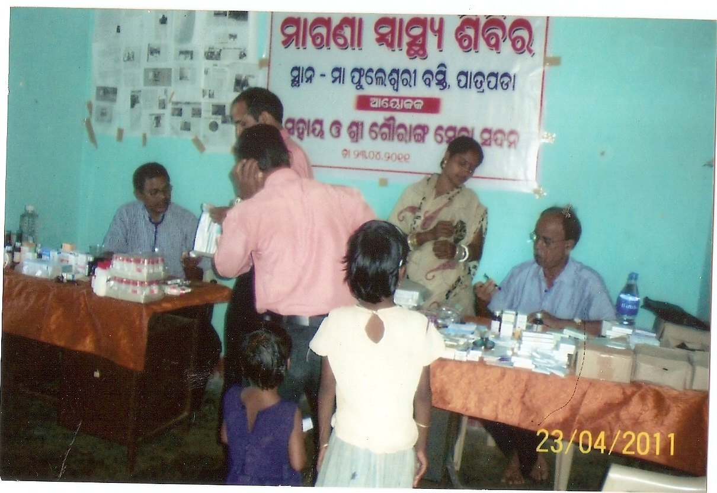
MEDICAL CAMP AT VILLAGE PATRAPADA, KHURDHA
23/04/2011

Slide 20
MEDICAL CAMP AT VILLAGE PATRAPADA, KHURDA
23/04/2011
NUMBER OF PATIENTS : 350
MAJOR DISEASES
  SCABIES
  FUNGUL INFECTION
  WORMS INFESTATION
SERVICES PROVIDED
FREE CONSULTANCY BY
  MEDICINE SPECIALISTS
  PEDEATRICIAN
  SKIN SPECIALIST
FREE DISRIBUTION OF MEDICINE

Slide 21
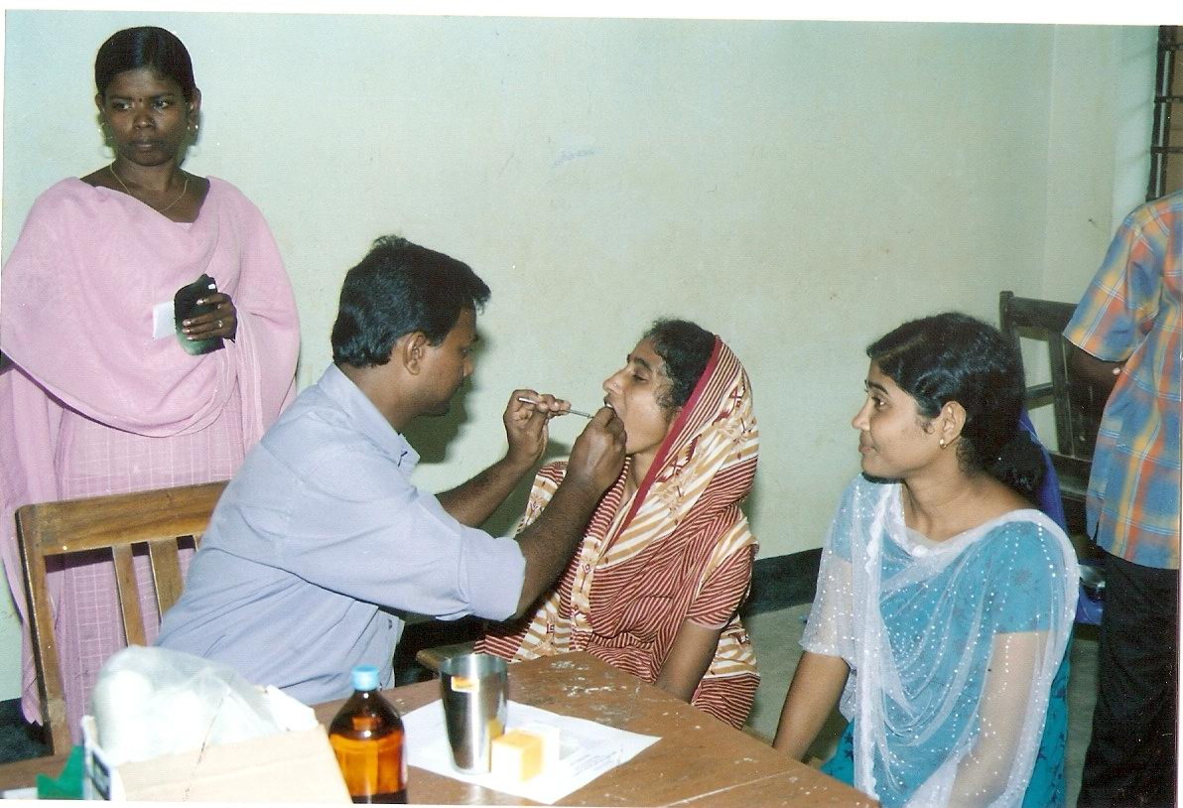
MEDICAL CAMP AT ICCHAPUR, JAGATSINGHPUR
5/05/2011

Slide 22
MEDICAL CAMP AT ICCHAPUR, JAGATSINGHPUR
05/05/2011
ICCHAPUR IS IN DISTRICT JAGATSINGHPUR AROUND 85KMS FROM BHUBANESWAR. PRIMARY OCCUPATION IS FARMING.
NUMBER OF PATIENTS : 500
MAJOR DISEASES
  SCABIES
  GASTREONTOLOGICAL DISORDERS
SERVICES PROVIDED
FREE CONSULTANCY BY
  MEDICINE SPECIALIST
  GASTREONTOLOGIST
  SKIN SPECIALIST
FREE DISRIBUTION OF MEDICINE.
DISTRIBUTION OF NUTRITIONAL SUPLEMENTS.

Slide 23
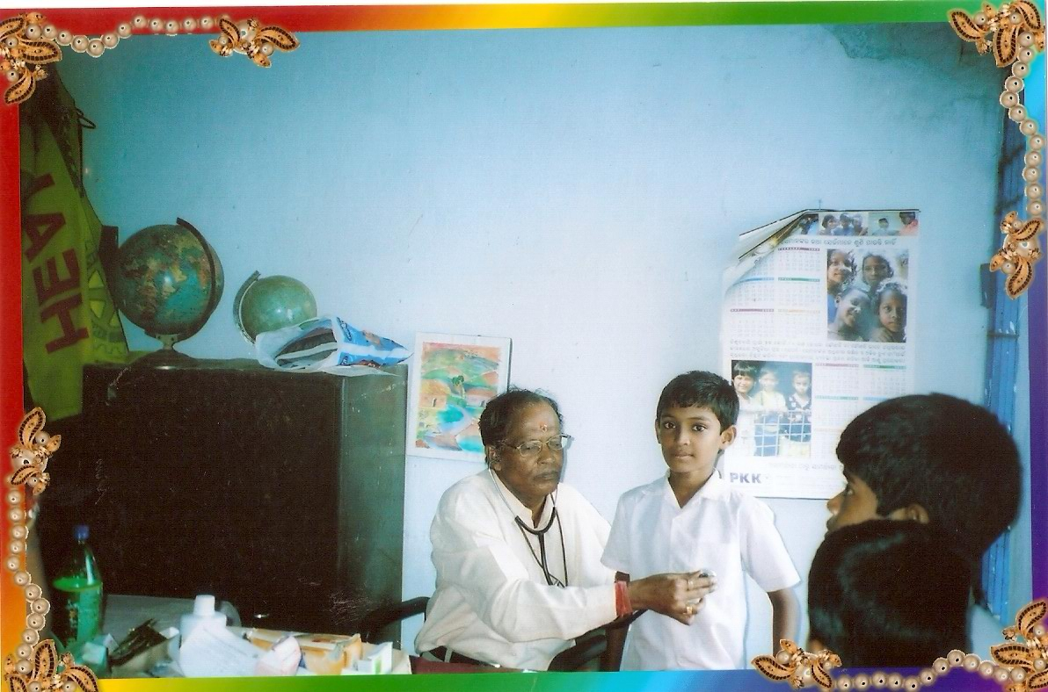
FREE MEDICAL CHECK-UP AT SCHOOL FOR THE
DEAF AND DUMB AT PALASPALLI, BHUBANESWAR
25/05/2011

Slide 24
FREE MEDICAL CHECK-UP AT SCHOOL FOR THE
DEAF AND DUMB AT PALASPALLI, BHUBANESWAR
25/05/2011
SCHOOL FOR THE DEAF AND DUMB IS A SEMI GOVERNMENT ORGANIZATION SITUATED IN PALAPALLI, BHUBANESWAR. IT HOUSES 120 DISABLED CHILDREN.
NUMBER OF PATIENTS : 200
MAJOR DISEASES
  SCABIES
  WORMS INFESTATION.
SERVICES PROVIDED
FREE CONSULTANCY BY
  MEDICINE SPECIALIST
  PEDEATRICIAN
  SKIN SPECIALIST.
FREE DISRIBUTION OF MEDICINE.
DISTRIBUTION OF NUTRITIONAL SUPLEMENTS.
BLOOD GROUPING.
H B TEST.
DONATION OF FIRST AID KIT , THERMOMETER AND WEIGHING MACHINE.

Slide 25
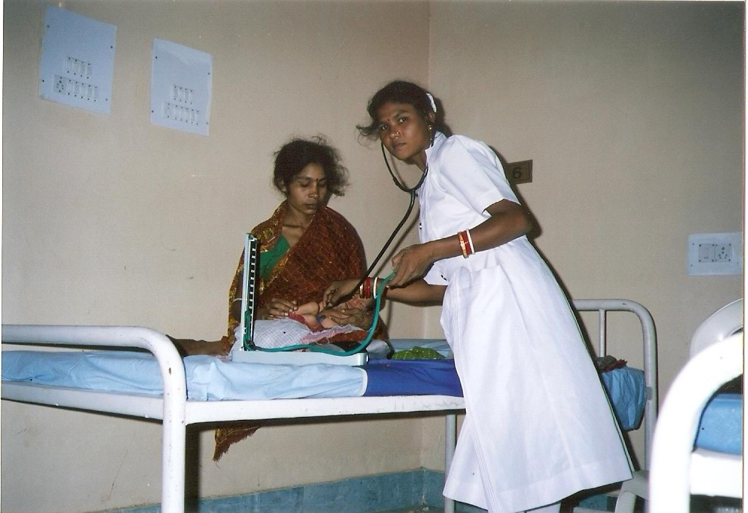
TREATMENT SPONSORED FOR SHANTI DEVI
TREATMENT SPONSORED FOR SHANTI DEVI

Slide 26
TREATMENT SPONSORED FOR SHANTI DEVI
SHANTI DEVI, AGED 22 YEAR HAD COME TO THE SEVA SADAN IN A SERIOUS CONDITION. SHE HAD SEVERAL COMPLICATIONS AND NEEDED IMMEDIATE C-SECTION. THE SEVA SDAN SPONSORED HER TREATMENT AND A BABY BOY WAS BORN.
THE CHILD AND THE MOTHER ARE IN GOOD HEALTH.

Slide 27
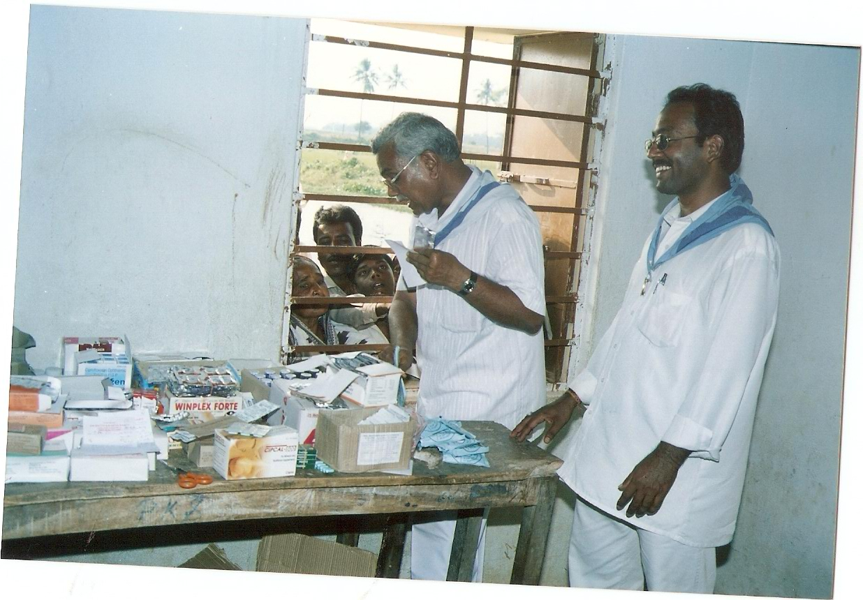
MEDICINE DISTRIBUTION IN MEDICAL CAMP HELD IN SALISAI BASTI, BHUBANESWAR
30/05/2011

Slide 28
MEDICINE DISTRIBUTION IN MEDICAL CAMP HELD IN SALISAI BASTI, BHUBANESWAR
30/05/2011
SALIA SAI BASTI IS THE BIGGEST SLUM AREA IN BHUBANESWAR. IT COMPRISES OF PEOPLE FROM VARIOUS PARTS OF ORISSA. THE MAJORITY OF THE POPULATION ARE DAILY WAGE LABOURERS AND ARTISANS.
NUMBER OF PATIENTS : 200
MAJOR DISEASES
  SCABIES
  MALARIA
  FILARIA
  MALNUTRITION
  GASTREONTOLOGICAL DISODER
SERVICES PROVIDED
FREE CONSULTANCY BY
  MEDICINE SPECIALIST
  PEDEATRICIAN
  SKIN SPECIALIST.
  GYNAECHOLOGIST
  GASTREONTOLOGIST
FREE DISRIBUTION OF MEDICINES. DISTRIBUTION OF NUTRITIONAL SUPLEMENTS. BLOOD GROUPING. H B TEST.

Slide 29
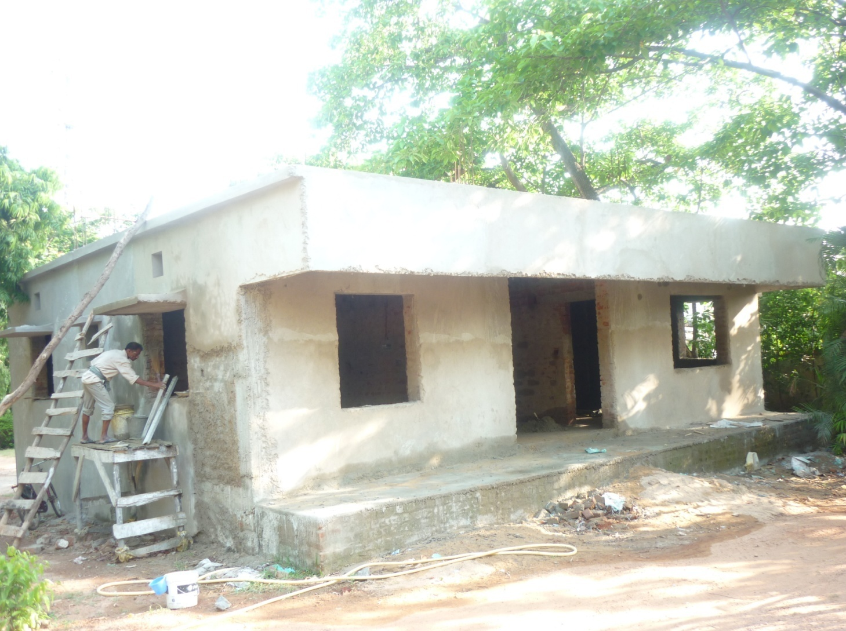
CHARITABLE DISPENSARY UNDER CONSTRUCTION AT BHUBANESWAR
02/06/2011 ( PLASTERING IN PROGRESS)

Slide 30
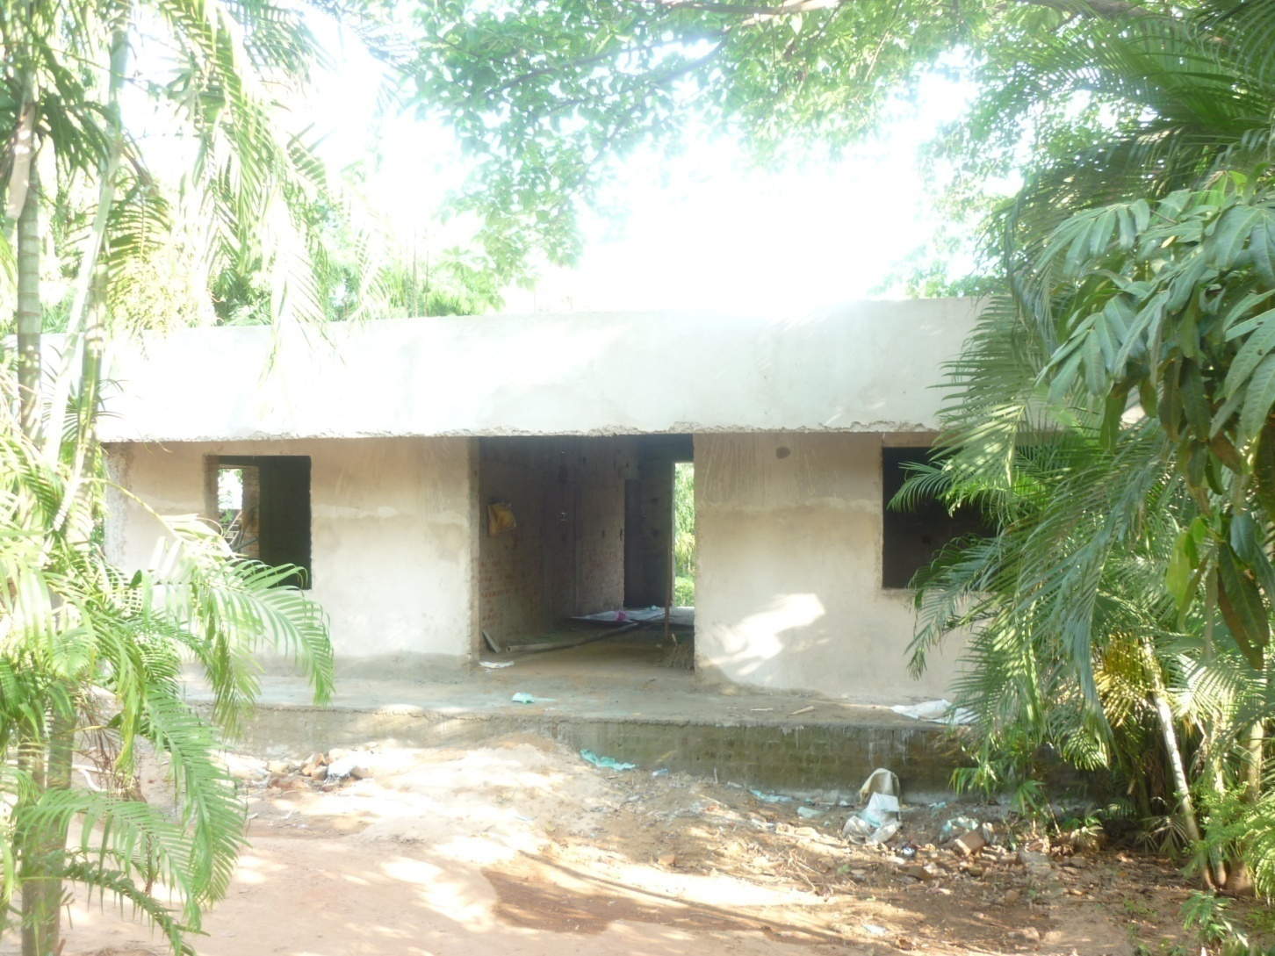
CHARITABLE DISPENSARY UNDER CONSTRUCTION AT BHUBANESWAR
02/06/2011 (FRONT ELEVATION)

Slide 31
THANK YOU

